Slide 1


UNIT 1; With you from the start
Rules, rules

Slide 2
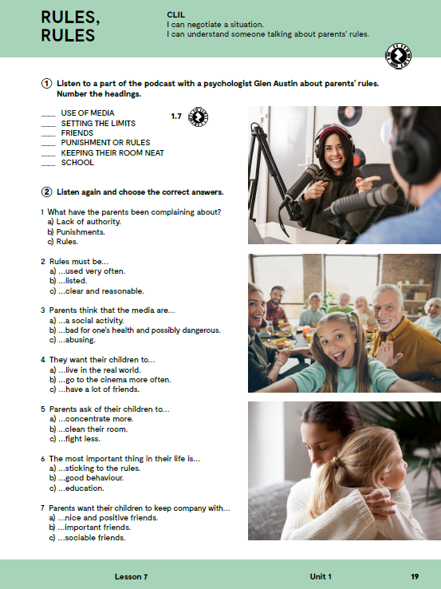

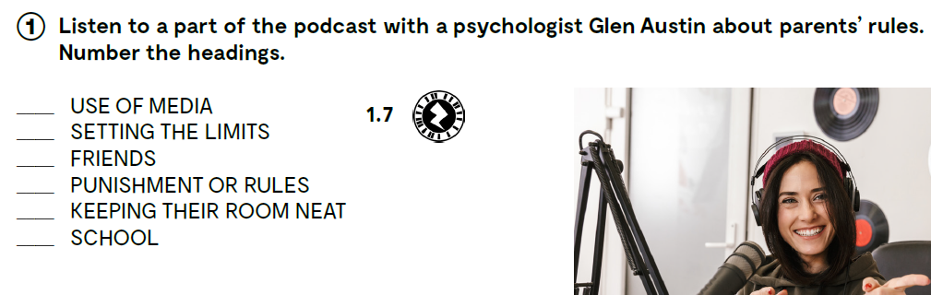
https://www.e-sfera.hr/dodatni-digitalni-sadrzaji/2b4c39f1-7fb9-4131-a918-afcf0d94e580/assets/audio/06_u1__l7_rules__rules_2.mp3
Check!
3
2
4
1
5
6

Slide 3
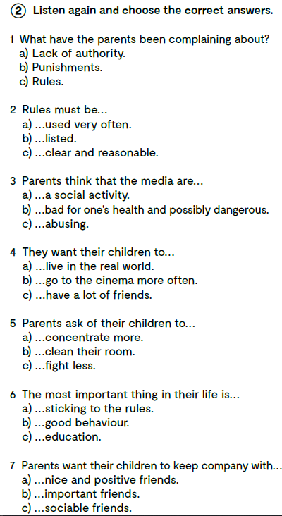
Listen again and choose the correct answers.
Poslušaj zvučni zapis na sljedećoj poveznici još jednom i zaokruži točan odgovor.
https://www.e-sfera.hr/dodatni-digitalni-sadrzaji/2b4c39f1-7fb9-4131-a918-afcf0d94e580/assets/audio/06_u1__l7_rules__rules_2.mp3

Slide 4
to negotiate
to extend
a curfew
to whine
to beg
to throw a temper tantrum
a solution
a sleepover
in spite of
a win-win situation/result
to set the limit
to complain
punishment
to keep one’s room neat
a lack of authority
reasonable
abusing
to stick to the rules
arguments
mature
respectful
postaviti granice
žaliti se
kazna
imati čistu sobu
nedostatak autoriteta
razuman
zloupotrijebiti
držati se pravila
argumenti
zreli
pun poštovanja
pregovarati
proširiti
vrijeme dolaska kući
cmizdriti
moliti
imati ispad bijesa
rješenje
prespavati
unatoč
situacija u kojoj su svi zadovoljni

Slide 5

Listen again and choose the correct answers.
https://www.e-sfera.hr/dodatni-digitalni-sadrzaji/2b4c39f1-7fb9-4131-a918-afcf0d94e580/assets/audio/06_u1__l7_rules__rules_2.mp3
Check!

Slide 6

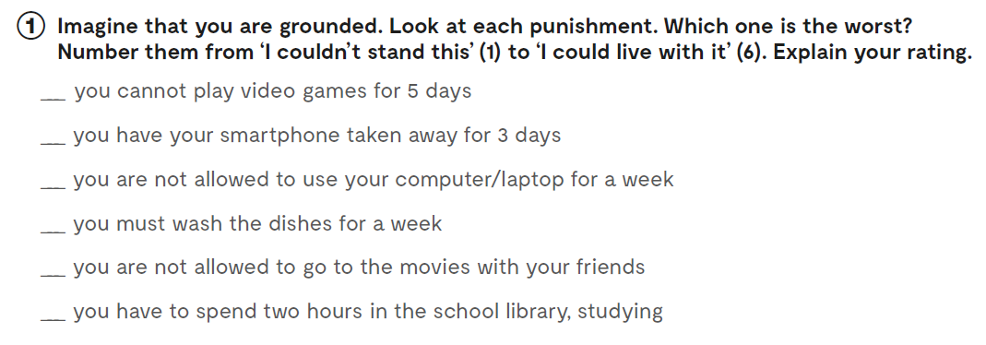
Workbook, page 17.

Slide 7
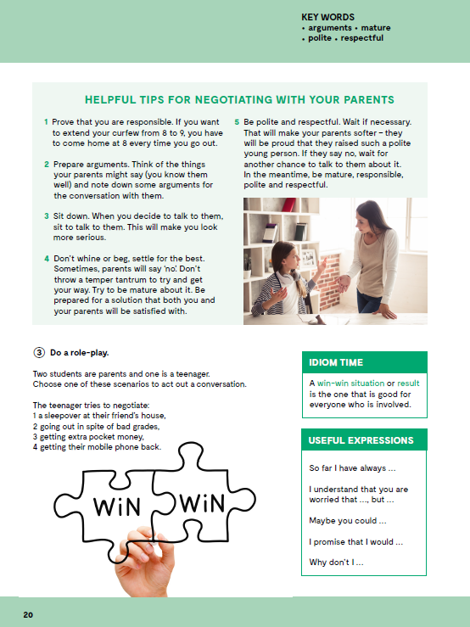
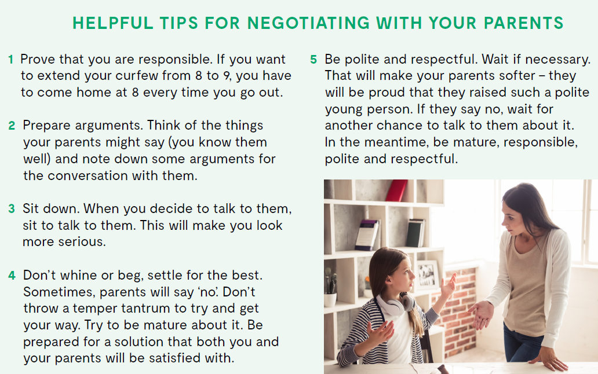
How can you prove to your parents that you are responsible?
What can you do to extend your curfew?
What will make you look more serious when talking to your parents?
What is it that you should or shouldn’t do if you want to reach a win-win solution to your problem?

Slide 8
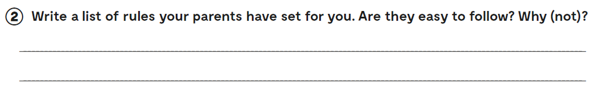
Let’s practise:
https://learningapps.org/watch?v=pe30ecgwc20
Workbook, page 17.

Slide 9
